Slide 1
UNIT II
Basic Processing Unit

Slide 2
Some Fundamental Concepts

Slide 3
Fundamental Concepts
Processor fetches one instruction at a time and perform the operation specified.
Instructions are fetched from successive memory locations until a branch or a jump instruction is encountered.
Processor keeps track of the address of the memory location containing the next instruction to be fetched using Program Counter (PC).
Instruction Register (IR)-Instruction fetched from the memory are kept in IR in CPU.

Slide 4
Executing of an Instruction
Fetch Phase
Fetch the contents of the memory location pointed to by the PC. The contents of this location are loaded into the IR (fetch phase).
IR ← [[PC]]
Assuming that the memory is byte addressable, increment the contents of the PC by 4 (fetch phase).
PC ← [PC] + 4
Execution Phase
Carry out the actions specified by the instruction in the IR (execution phase).

Slide 5
SINGLE BUS ORGANIZATION OF PROCESSOR
In a single bus organisation, all major units of the processor (registers, ALU, memory interface, etc.) are connected to a common internal bus.
Only one data transfer can occur at a time across this bus.

Slide 6
Internal processor
bus
Control signals
PC
Address
Instruction
lines
decoder and
MAR
control logic
Memory
bus
Data
MDR
lines
IR
Y
Constant 4
R0
Select
MUX
Add
A
B
Sub
R
(
n
-
1
ALU
)
control
ALU
lines
XOR
Carry-in
TEMP
Z
Figure 7.1. Single-bus organization of the datapath inside a processor.

Slide 7
MAIN COMPONENTS
Single Internal Processor Bus:
﻿Connects all units.
﻿Only one unit can send data at a time; others must wait.
Registers:
﻿PC (Program Counter): Points to the next instruction.
﻿IR (Instruction Register): Stores current instruction.
﻿RO to R(n-1): General-purpose registers.
﻿TEMP, Y, Z: Temporary storage for operations.

Slide 8
Memory Interface:
﻿MAR (Memory Address Register): Holds address for memory access.
﻿MDR (Memory Data Register): Holds data from/to memory.
Control Unit:
•Instruction Decoder and Control Logic: Generates control signals for operations.
ALU (Arithmetic Logic Unit):
﻿Performs arithmetic and logic operations using inputs A and B.
﻿Gets input from Y and MUX.
﻿Outputs result to Z.
MUX (Multiplexer):
•Selects between constant values or register data as ALU input.

Slide 9
HOW IT WORKS ?
Fetch Phase:
﻿PC → MAR → Memory → MDR → IR.
﻿Instruction is fetched using a sequence of bus transfers.
Decode Phase:
﻿IR sends opcode to the control unit.
﻿Control signals are generated.
Execute Phase:
﻿Operands moved via bus to ALU.
﻿ALU performs operation.
﻿﻿Result stored in Z or another

Slide 10
Executing an Instruction
Transfer a word of data from one processor register to another or to the ALU.
Perform an arithmetic or a logic operation and store the result in a processor register.
Fetch the contents of a given memory location and load them into a processor register.
Store a word of data from a processor register into a given memory location.

Slide 11
Register Transfers
All operations and data transfers are controlled by the processor clock.
Bus
0
D
Q
1
Q
R
i
out
R
i
in
Clock
Figure 7.3. Input and output gating for one register bit.

Slide 12
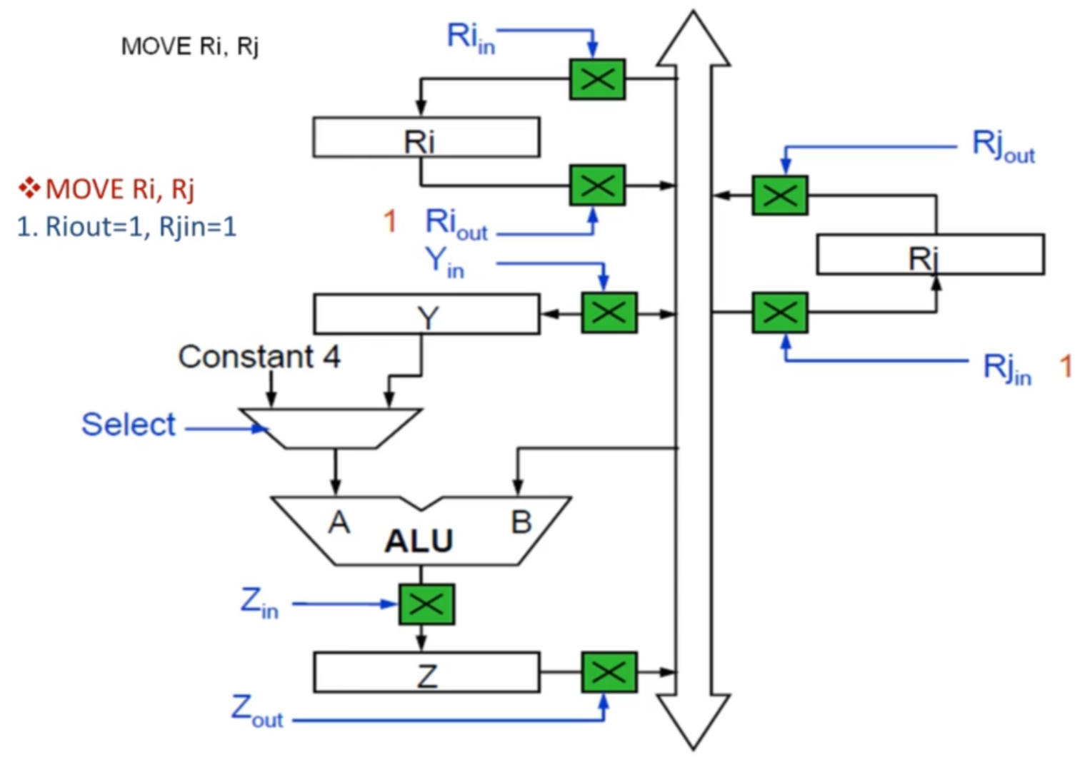
Register Transfers

Slide 13
Key Elements and Flow Explanation:
1. Ri (General-Purpose Register):
﻿Stores a value that can be used as an operand.
﻿Rin: Control signal to load data into Ri from the bus.
﻿Rout: Control signal to place data from Ri onto the bus.
2. Y Register:
﻿Temporary register to hold the first operand for the ALU.
﻿Yin: Loads data from the bus into Y.
3. MUX (Multiplexer):
•Selects between a constant value or data from another source for the second operand to the ALU.

Slide 14
4. ALU (Arithmetic Logic Unit):
﻿Performs operations like Add, Sub, AND, OR, etc.
﻿Takes two inputs:
﻿﻿A from MUX
﻿﻿B from Y
﻿Produces result based on ALU control inputs.
5. Z Register:
﻿Temporary register to store ALU output.
﻿Zin: Loads result from ALU.
﻿Zout: Places result from Z onto the internal bus.

Slide 15
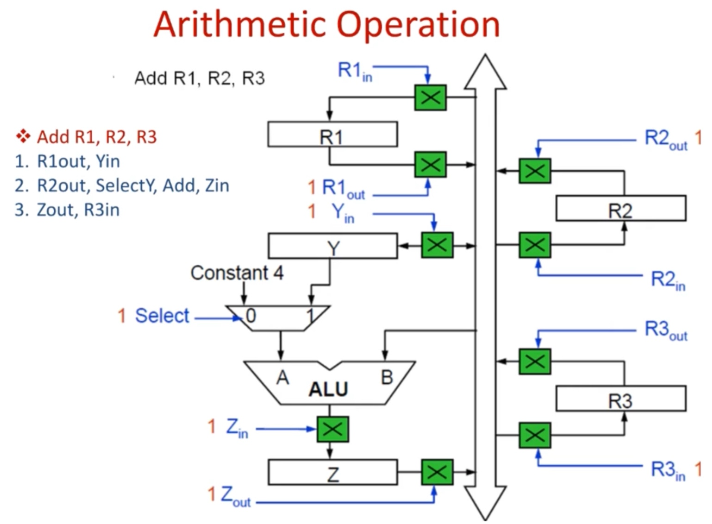

Slide 16
Performing an Arithmetic or Logic Operation
The ALU is a combinational circuit that has no internal storage.
ALU gets the two operands from MUX and bus. The result is temporarily stored in register Z.
What is the sequence of operations to add the contents of register R1 to those of R2 and store the result in R3?
R1out, Yin
R2out, SelectY, Add, Zin
Zout, R3in

Slide 17
Fetching a Word from Memory
The response time of each memory access varies (cache miss, memory-mapped I/O,…).
To accommodate this, the processor waits until it receives an indication that the requested operation has been completed (Memory-Function-Completed, MFC).
Move (R1), R2
MAR ← [R1]
Start a Read operation on the memory bus
Wait for the MFC response from the memory
Load MDR from the memory bus
R2 ← [MDR]

Slide 18
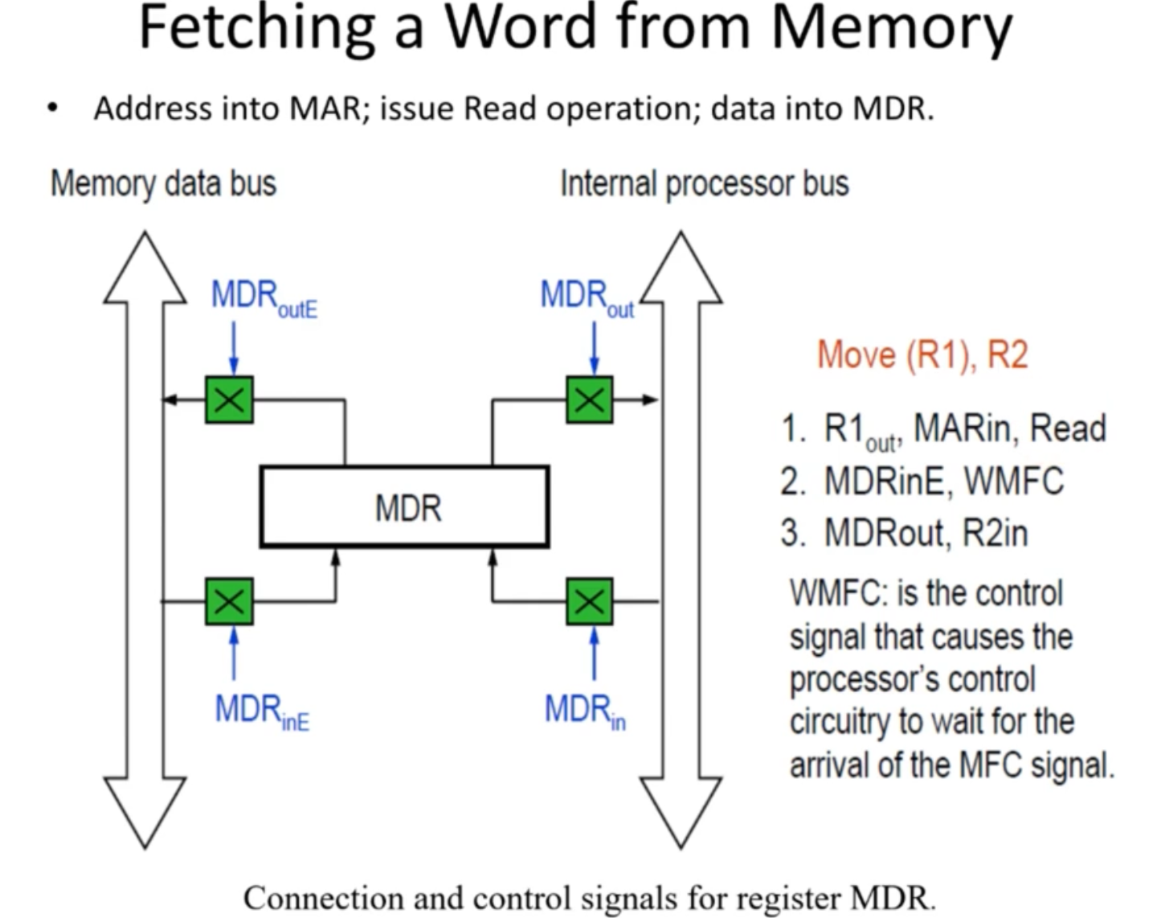

Slide 19
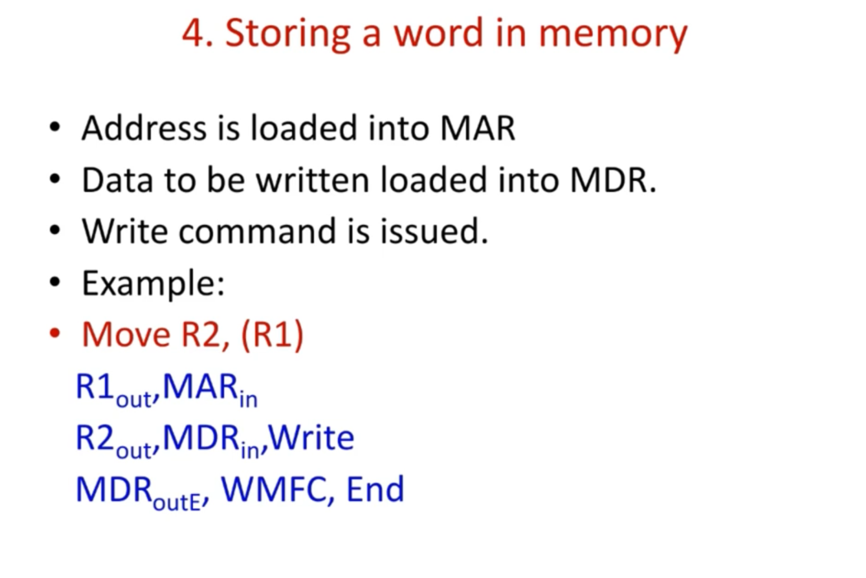

Slide 20
Execution of a Complete Instruction
Add (R3), R1
Fetch the instruction
Fetch the first operand (the contents of the memory location pointed to by R3)
Perform the addition
Load the result into R1

Slide 21
Architecture
Internal processor
b
us
R
i
in
R
i
R
i
out
Y
in
Y
Constant 4
Select
MUX
A
B
ALU
Z
in
Z
Z
out
Figure: Input and output gating for the registers.

Slide 22
Execution of a Complete Instruction
Internal processor
Add (R3), R1
bus
Control signals
PC
Step
Action
Address
Instruction
lines
decoder and
MAR
control logic
1
PC
out
,
MAR
in
,
Read,
Select4,
Add,
Z
Memory
in
bus
2
Z
out
,
PC
in
,
Y
,
WMF
C
MDR
in
Data
3
MDR
out
,
IR
in
lines
IR
4
R3
out
,
MAR
in
,
Read
Y
5
R1
out
,
Y
,
WMF
C
Constant 4
R0
in
6
MDR
out
,
SelectY,
Add,
Z
Select
in
MUX
7
Z
out
,
R1
,
End
in
Add
Sub
A
B
R
(
n
-
1
ALU
)
control
ALU
lines
XOR
Carry-in
Figure:
Con
trol
sequence
for
execution
of
the
instruction
Add
(R3),R1.
TEMP
Z
Figure 7.1. Single-bus organization of the datapath inside a processor.

Slide 23
Execution of Branch Instructions
A branch instruction replaces the contents of PC with the branch target address, which is usually obtained by adding an offset X given in the branch instruction.
The offset X is usually the difference between the branch target address and the address immediately following the branch instruction.
Conditional branch

Slide 24
Step
Action
1
PC
out
,
MAR
in
,
Read,
Select4,
Add,
Z
in
2
Z
out
,
PC
in
,
Y
in
,
WMF
C
3
MDR
out
,
IR
in
4
Offset-field-of-IR
out
,
Add,
Z
in
5
Z
out
,
PC
in
,
End
Figure : Control sequence for an unconditional branch instruction.

Slide 25
Pipelining

Slide 26
Overview
Pipelining is widely used in modern processors.
Pipelining improves system performance in terms of throughput.
Pipelined organization requires sophisticated compilation techniques.

Slide 27
Basic Concepts

Slide 28
Making the Execution of Programs Faster
Use faster circuit technology to build the processor and the main memory.
Arrange the hardware so that more than one operation can be performed at the same time.
In the latter way, the number of operations performed per second is increased even though the elapsed time needed to perform any one operation is not changed.

Slide 29
Traditional Pipeline Concept
Laundry Example
Ann, Brian, Cathy, Dave each have one load of clothes to wash, dry, and fold
Washer takes 30 minutes
Dryer takes 40 minutes
Folder takes 20 minutes
A
B
C
D

Slide 30
6 PM
7
8
9
10
11
Midnight
Time
30
40
20
30
40
20
30
40
20
30
40
20
Sequential laundry takes 6 hours for 4 loads
If they learned pipelining, how long would laundry take?
A
B
C
D

Slide 31
6 PM
7
8
9
10
11
Midnight
T
a
s
k
O
r
d
e
r
Time
30
40
40
40
40
20
A
Pipelined laundry takes 3.5 hours for 4 loads
B
C
D

Slide 32
Traditional Pipeline Concept
6 PM
7
8
9
Pipelining doesn’t help latency of single task, it helps throughput of entire workload
Pipeline rate limited by slowest pipeline stage
Multiple tasks operating simultaneously using different resources
Potential speedup = Number pipe stages
Unbalanced lengths of pipe stages reduces speedup
Time to “fill” pipeline and time to “drain” it reduces speedup
Stall for Dependences
Time
T
a
s
k
O
r
d
e
r
30
40
40
40
40
20
A
B
C
D

Slide 33
Use the Idea of Pipelining in a Computer
Fetch + Execution
T
ime
I
1
I
2
I
3
T
ime
Clock cycle
1
2
3
4
F
1
E
1
F
2
E
2
F
3
E
3
Instruction
(a) Sequential execution
I
1
F
1
E
1
I
2
F
2
E
2
Interstage buffer
B1
I
3
F
3
E
3
Instruction
Ex
ecution
fetch
unit
(c) Pipelined execution
unit
(b) Hardware organization
Basic idea of instruction pipelining.

Slide 34
Fetch + Decode+ Execution + Write
T
ime
Clock cycle
1
2
3
4
5
6
7
Instruction
I
F
1
1
E
1
W
1
1
D
I
F
2
D
2
E
2
W
2
2
I
F
3
D
3
E
3
W
3
3
I
F
4
D
4
E
4
W
4
4
(a) Instruction execution divided into four steps
fers
Interstage b
uf
F : Fetch
D : Decode
instruction
instruction
E: Ex
ecute
W : Write
and fetch
operation
results
operands
B1
B2
B3
(b) Hardware organization
A 4-stage pipeline.

Slide 35
Role of Cache Memory
Each pipeline stage is expected to complete in one clock cycle.
The clock period should be long enough to let the slowest pipeline stage to complete.
Faster stages can only wait for the slowest one to complete.
Since main memory is very slow compared to the execution, if each instruction needs to be fetched from main memory, pipeline is almost useless.
Fortunately, we have cache.

Slide 36
Pipeline Performance
The potential increase in performance resulting from pipelining is proportional to the number of pipeline stages.
However, this increase would be achieved only if all pipeline stages require the same time to complete, and there is no interruption throughout program execution.
Unfortunately, this is not true.

Slide 37
T
ime
Clock c
ycle
1
2
3
4
5
6
7
8
9
Instruction
I
F
D
E
W
1
1
1
1
1
I
F
D
E
W
2
2
2
2
2
I
F
D
E
W
3
3
3
3
3
I
F
D
E
W
4
4
4
4
4
I
F
D
E
5
5
5
5
Figure:
ycle.
Ef
fect of an e
x
ecution operation taking more than one clock c

